Slide 1
What is the most engaging game on steam?

Slide 2
Agenda
Find the video games that people, on average are playing particularly more than others.

Slide 3

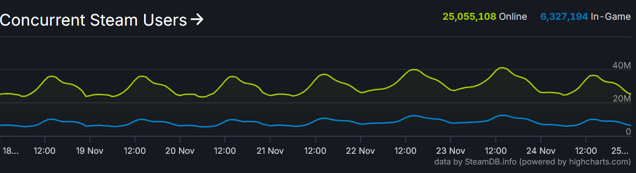
Challenges
How do you define ‘engagement’?
Where do you acquire the necessary data?
How do you filter out the shovel-ware from steam’s massive and free-to-publish-on library?
Not Trivial!

Slide 4
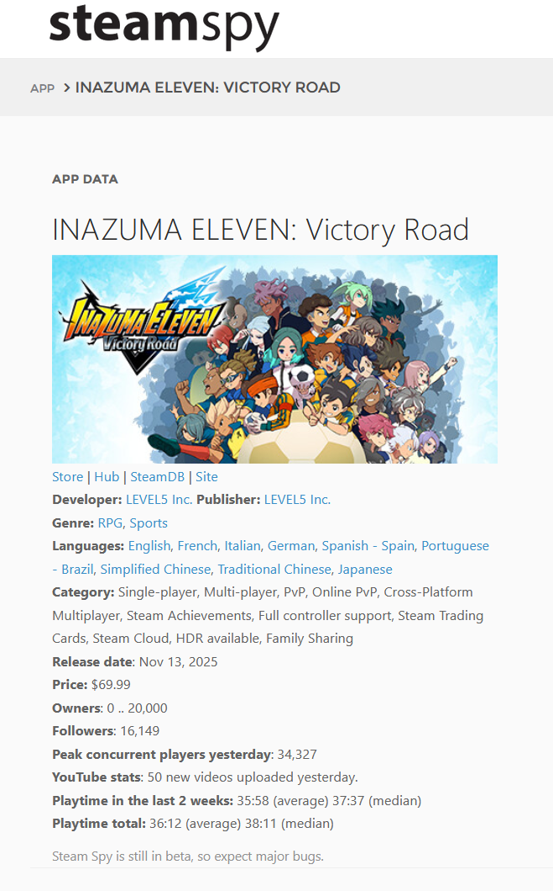
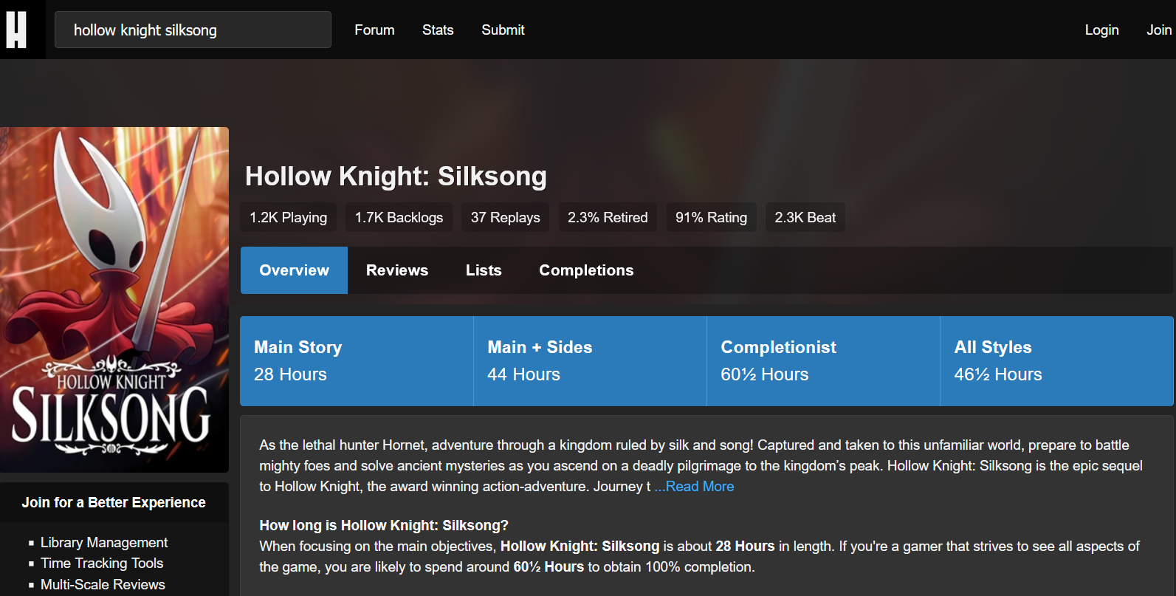

The Datasets
Steamspy
HowLongToBeat

Slide 5
Scraping, Cleaning and Filtering Challenges
DATASET
Mismatches
Empty entries
Inaccurate statistics
STEAM
Shovel-ware
​Apps and background processes
Outliers and skewers.

Slide 6
Mismatching names!
Grand Theft Auto V Legacy vs Grand Theft Auto V
Final Fantasy VII vs Final Fantasy 7
PUBG: Battlegrounds vs PUBG Battlegrounds

Slide 7
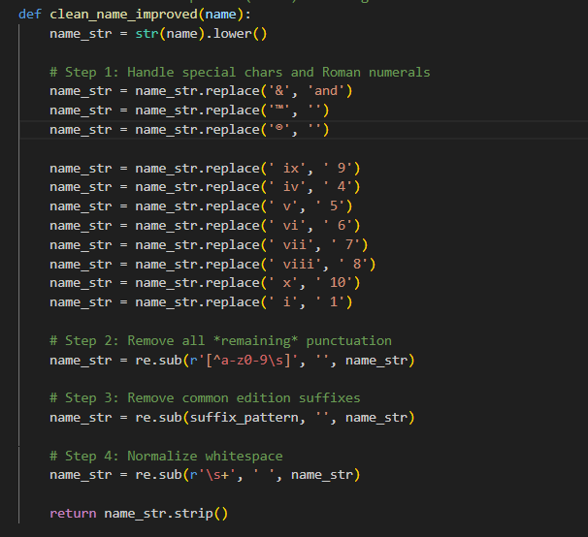

Slide 8
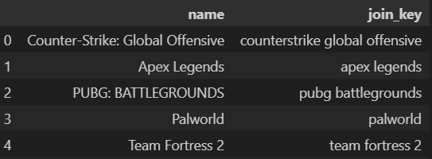
Final Fantasy VII vs Final Fantasy 7
Solution?
Clean names

Slide 9
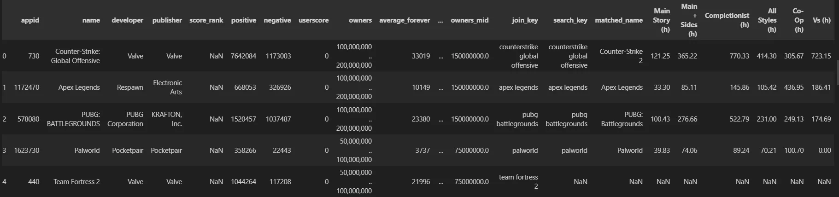
Initial Dataset after joining

Slide 10
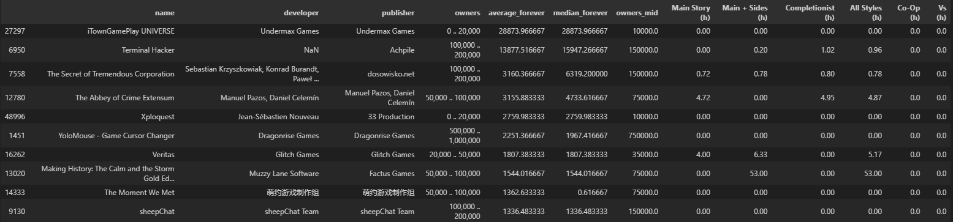
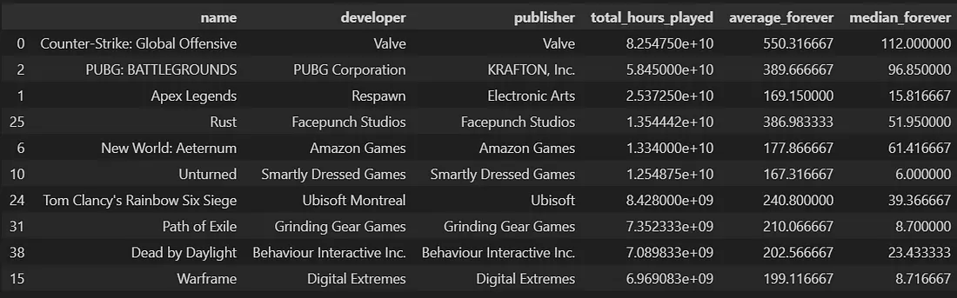
VS

Slide 11
Cleaning and Filtering Challenges
DATASET
Mismatches
Empty entries
Inaccurate statistics
STEAM
Shovel-ware
​Apps and background processes
Outliers and skewers.

Slide 12
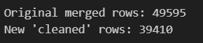
Eliminate rows without a HLTB column

Slide 13
Cleaning and Filtering Challenges
DATASET
Mismatches
Empty entries
Inaccurate statistics
STEAM
Shovel-ware
​Apps and background processes
Outliers and skewers.

Slide 14
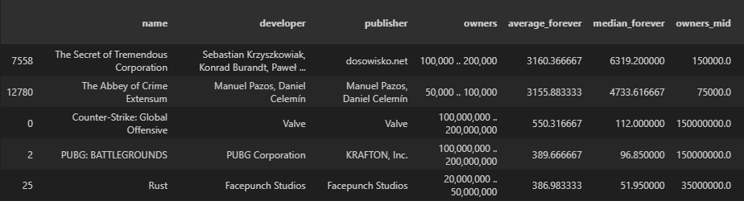
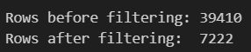
Solution: Set limits on playtime
Owners > 35000
Average Playtime Threshold > 2
Median Playtime Threshold > 1

Slide 15
Cleaning and Filtering Challenges
DATASET
Mismatches
Empty entries
Inaccurate statistics
STEAM
Shovel-ware
​Apps and background processes
Outliers and skewers.

Slide 16
Solution: Clip the games with strange statistics!
We define mean/median ratio.
Only consider those games with ratio > 1 and < 15. A ‘sane’ range.
In line with our average mean/median ratio of 2.67

Slide 17
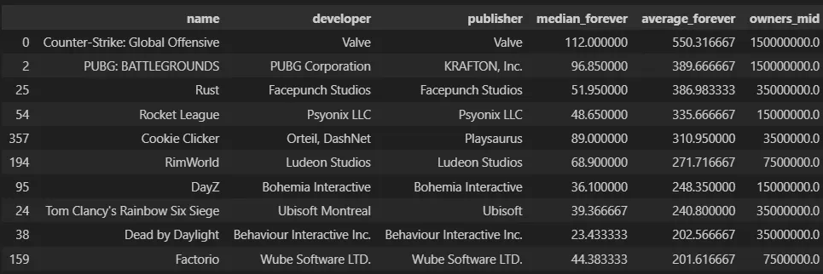

Slide 18
Cleaning and Filtering Challenges
DATASET
Mismatches
Empty entries
Inaccurate statistics
STEAM
Shovel-ware
​Apps and background processes
Outliers and skewers.

Slide 19
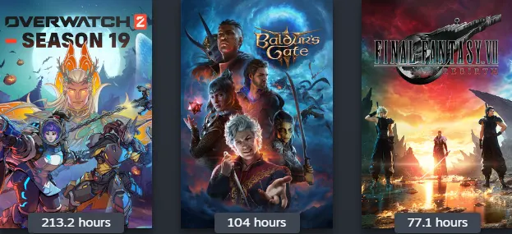

Single Player Analysis and How Long to beat

Slide 20

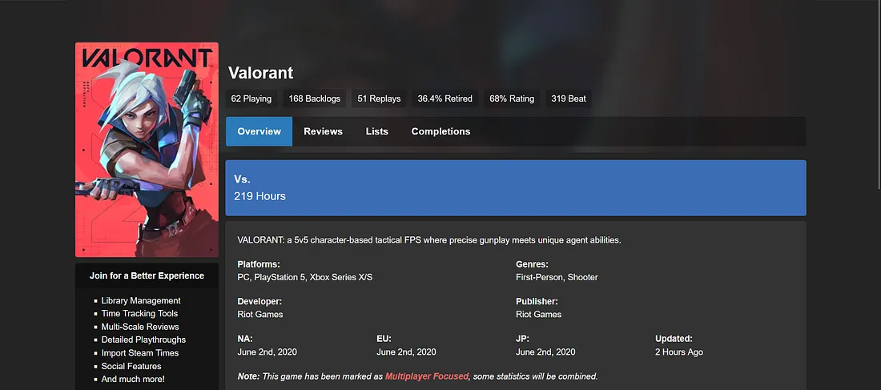

Slide 22
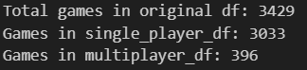
Measure?
Single player games have Main Story at least >= 2.5 their vs column.
We use this to split games into single and multiplayer data frames.

Slide 23
Here are the Final results:

Slide 24
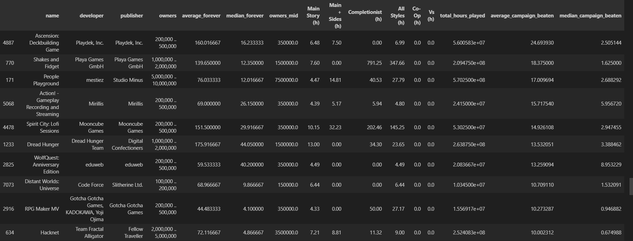
Single player sorted by average campaign beaten

Slide 25
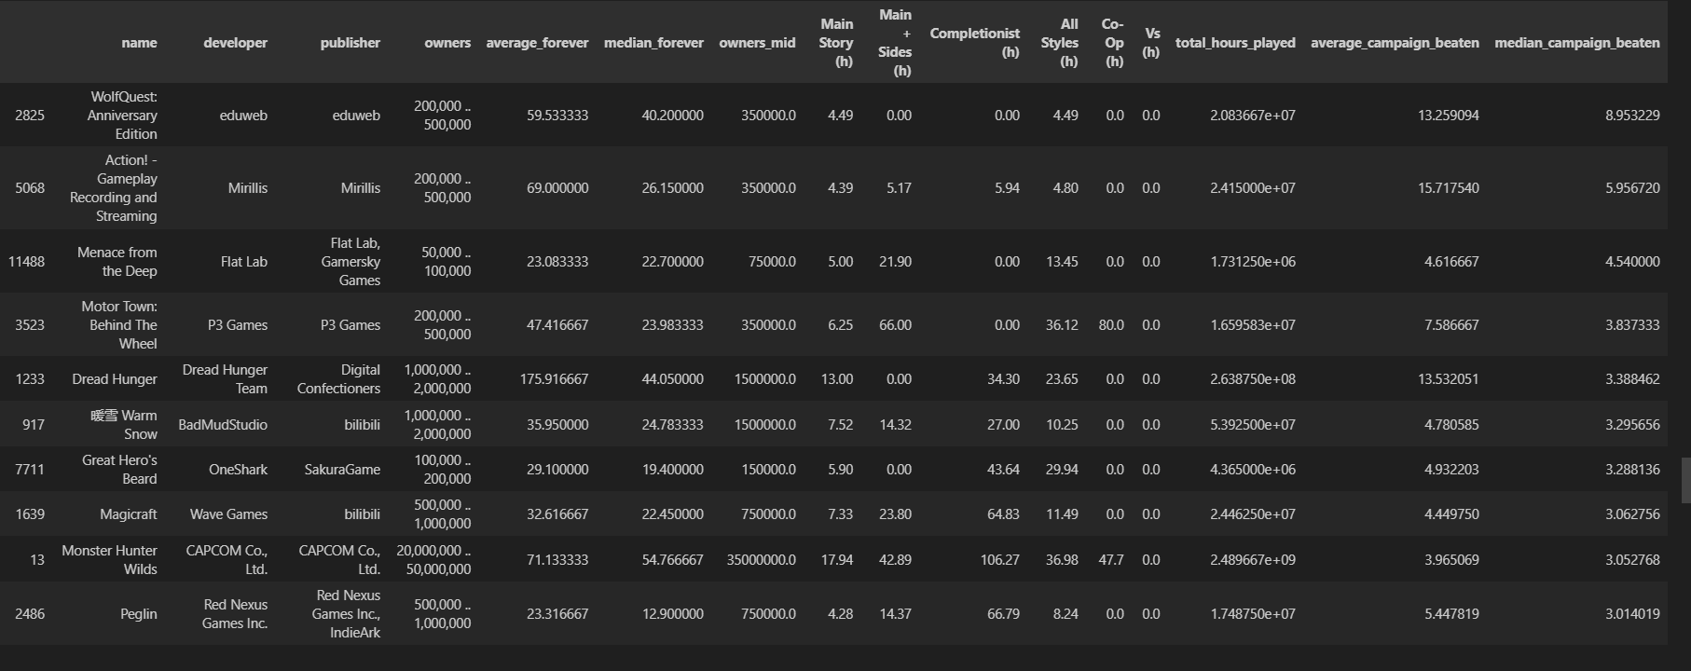
Single Player sorted by median campaign beaten

Slide 26
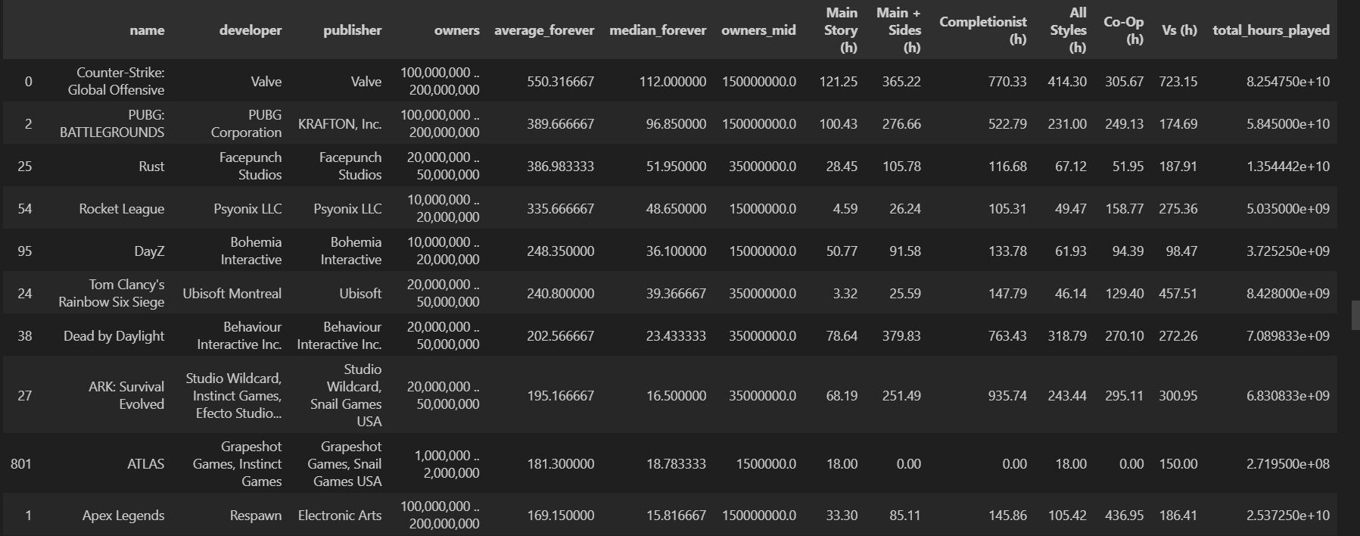
Multiplayer sorted by average

Slide 27
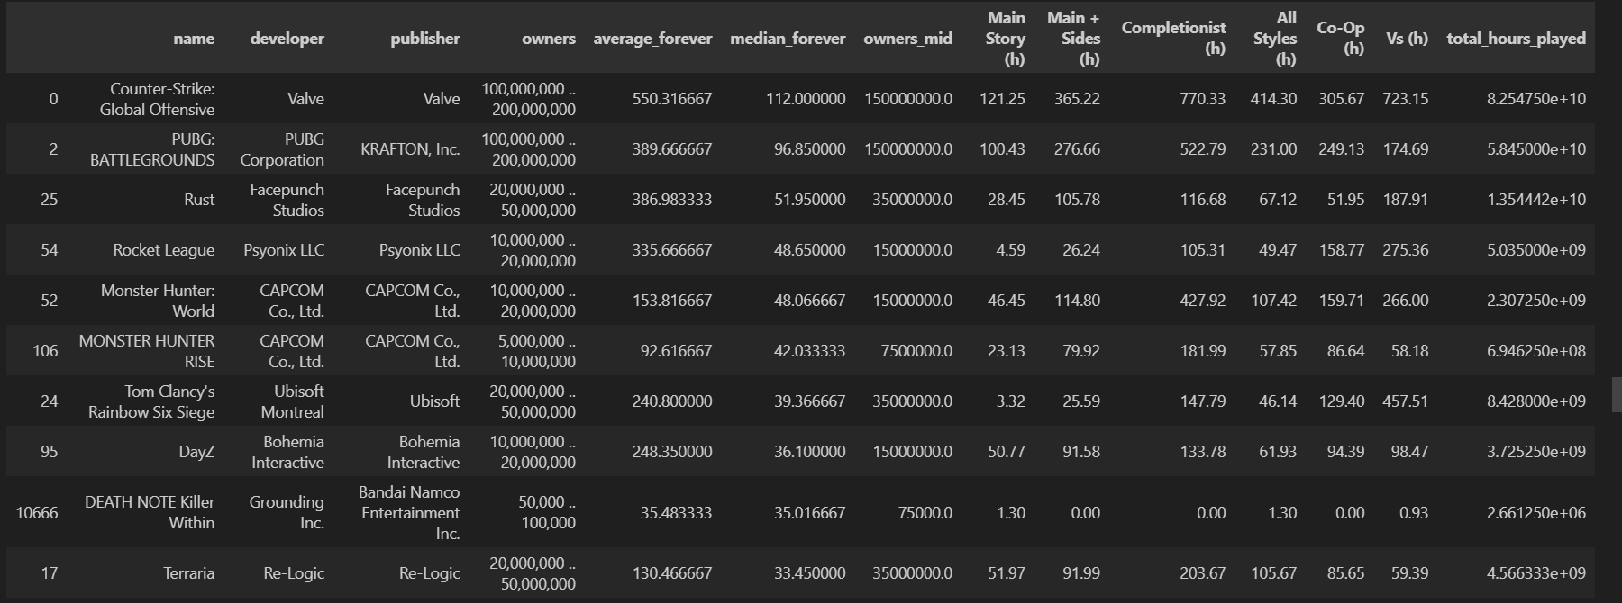
Multiplayer sorted by median

